Slide 1

Wine quality prediction
SHIVAM Dattatray SHINDE

Slide 2
Overall steps of the project
1
Exploring the data using the python notebook
2
Finding the preprocessing steps and best model for the data
3
Start working on the python code
4
Getting the input from the user using the HTML page and providing the predictions using the trained model

Slide 3
Working on the python code (Training)
1
Creating a YAML file to store all the project variables
2
Creating the method for data and variables loading
3
Creating methods for the preprocessing of the data
4
5
6
Training the model using the training set
Creating the methods for splitting the data into training and testing set
Evaluating the model using the test set

Slide 4
Working on the python code (Prediction)
1
Creating a HTML and CSS files to take the input from the user
2
Creating a python file containing the prediction methods
3
Creating the python flask app file

Slide 5

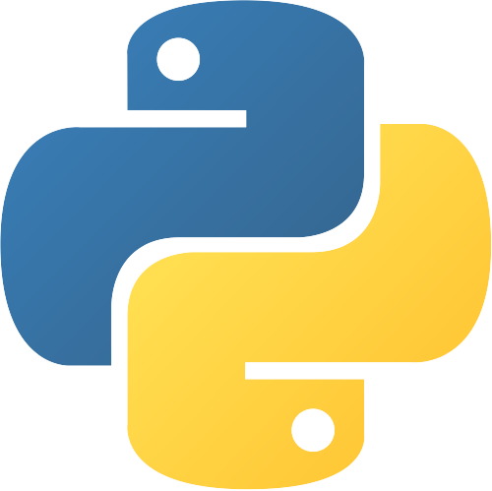
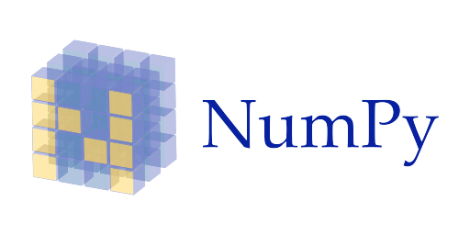



Libraries used for the project

